Slide 1
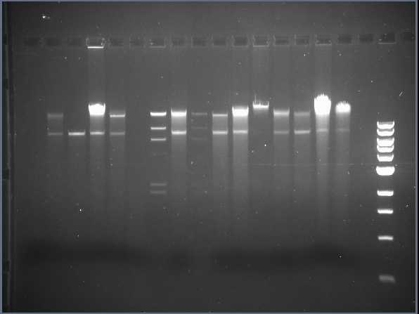
Dye Only
MS - SPN-221B
RJL - Aldie
RNB - Chantilly
DJS - Marcel
TM - T²B²
λ Standard 10 µl
SDU - Scotticus
λ Standard 1 µl
ARNC - YGNP
VEW - Vickster
HML - VABEACH
MWG - Glarcus
MBR - Rohlfyboy
KMB - Chattshavier
GHG - Heisenberg
GHG - Pinkman
1 kb Ladder
1 2 3 4 5 6 7 8 9 10 11 12 13 14 15 16 17 18

Slide 2
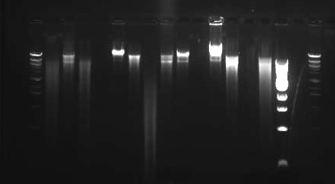
Dye Only
λ Stnd
ARNC-YGNP
DJS-Marcel
GHG.Heisenberg
GHG.Pinkman
HML-VABEACH
KMB - Chattshavier
MBR.Rohlfyboy
MWG-Glarcus
RJL-Aldie
RNB-Chantilly
SDU.Scotticus
MS-SPN-221B
TJ.T²B²
VEW.Vickster
1 kb Stnd
λ Stnd
HindIII digest
Section 2 MW
F 2013
1 2 3 4 5 6 7 8 9 10 11 12 13 14 15 16 17 18

