Slide 2
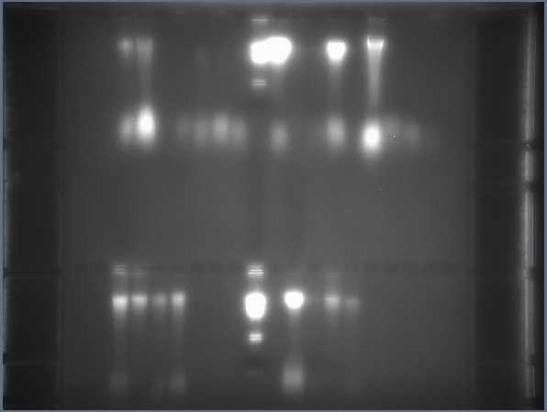
PG JOL EMT EMJ BCM RZW STD SAE CER JFK TAD ERG BS END GR
MBV MAH RS RS STD PEB SCN MID IR

